Slide 1
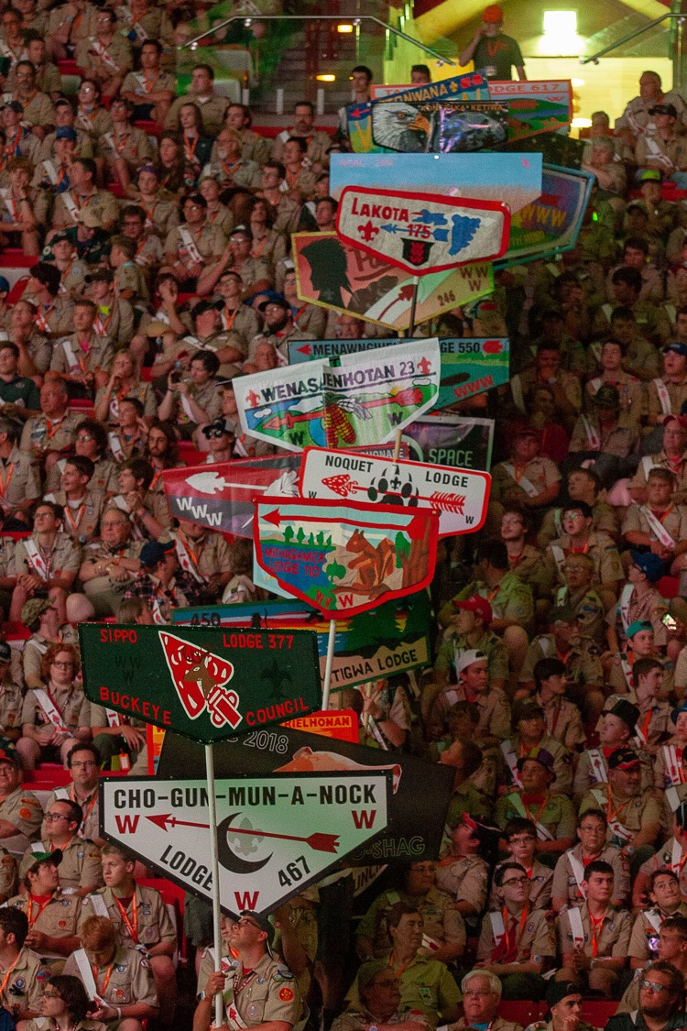


“Seek New Heights” at the
2024 National
Order of the Arrow Conference
July 29 – August 3, 2024
University of Colorado Boulder

Slide 2
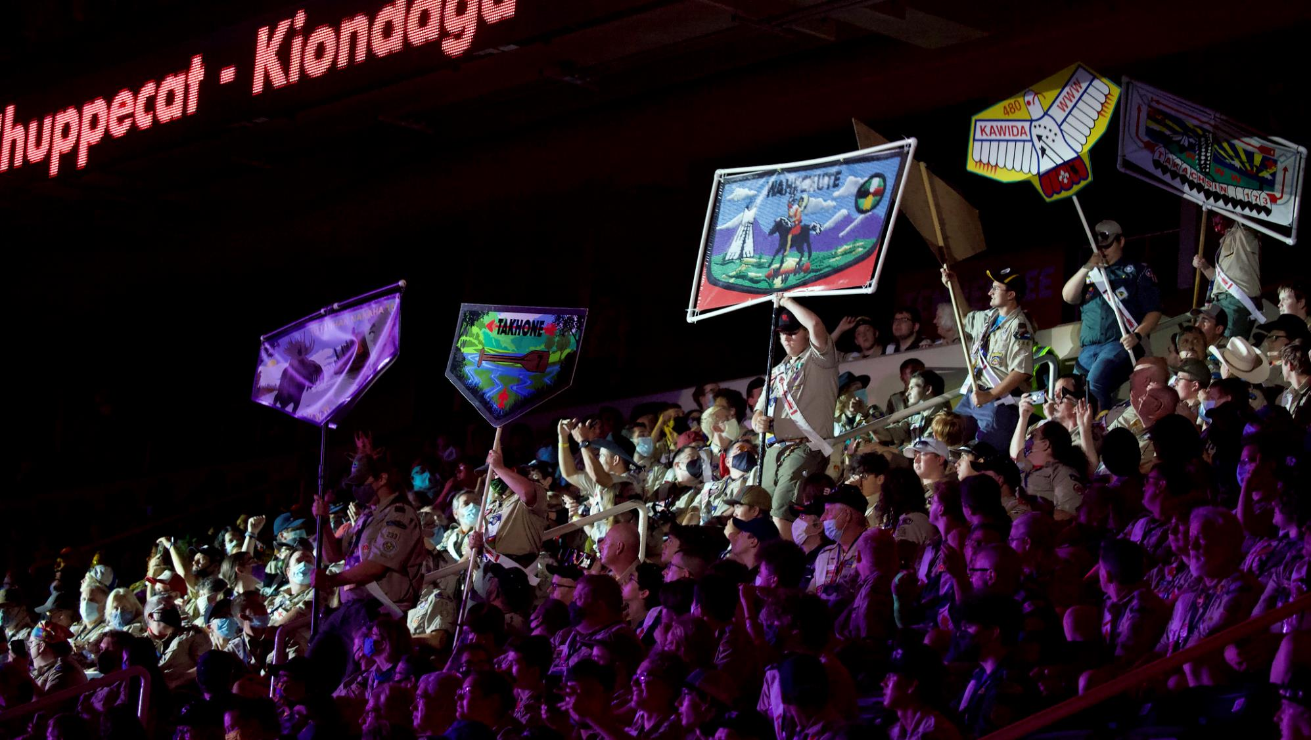

Slide 3
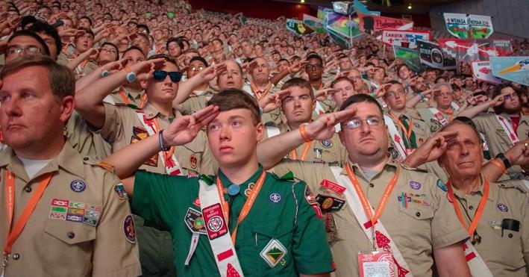

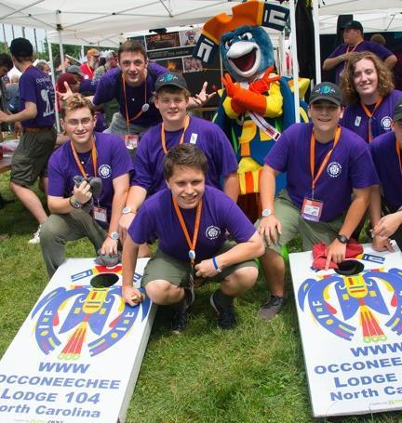
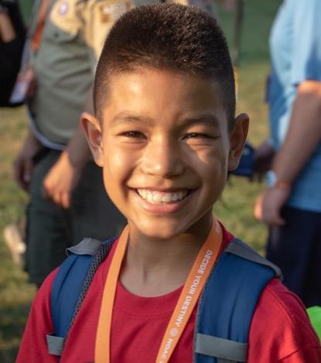
What is NOAC?
The National Order of the Arrow Conference (NOAC) is the Order of the Arrow’s premier national event with 6,000-8,000 Arrowmen participating from throughout the BSA. It is held approximately every two years with conference program that includes innovative leadership development, program, fellowship, and inspirational shows.

Slide 4
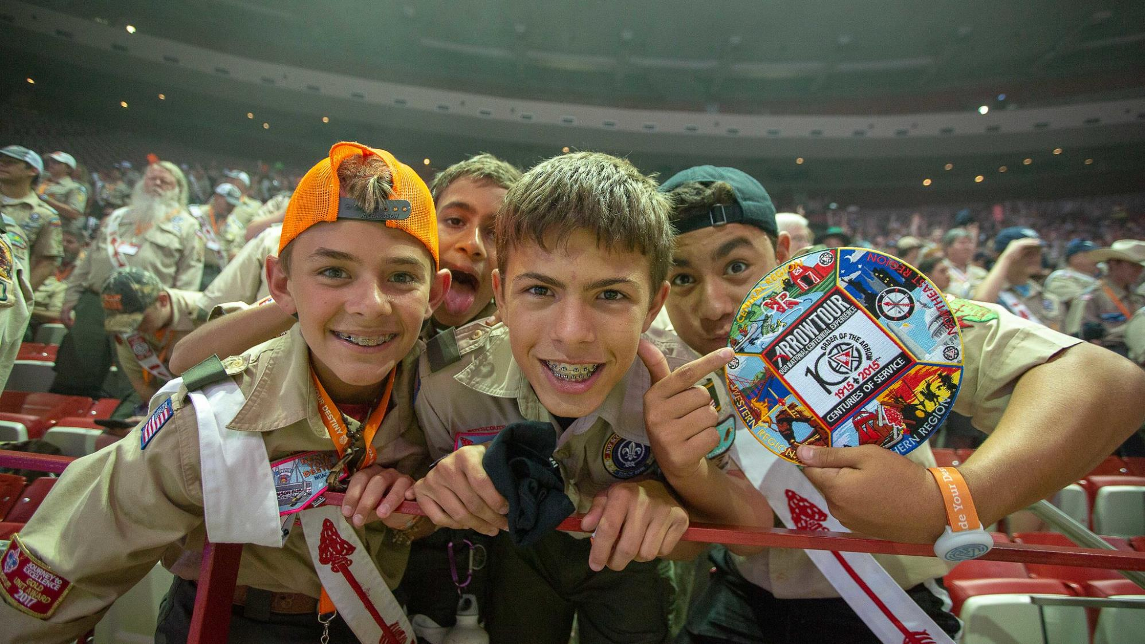

Slide 5
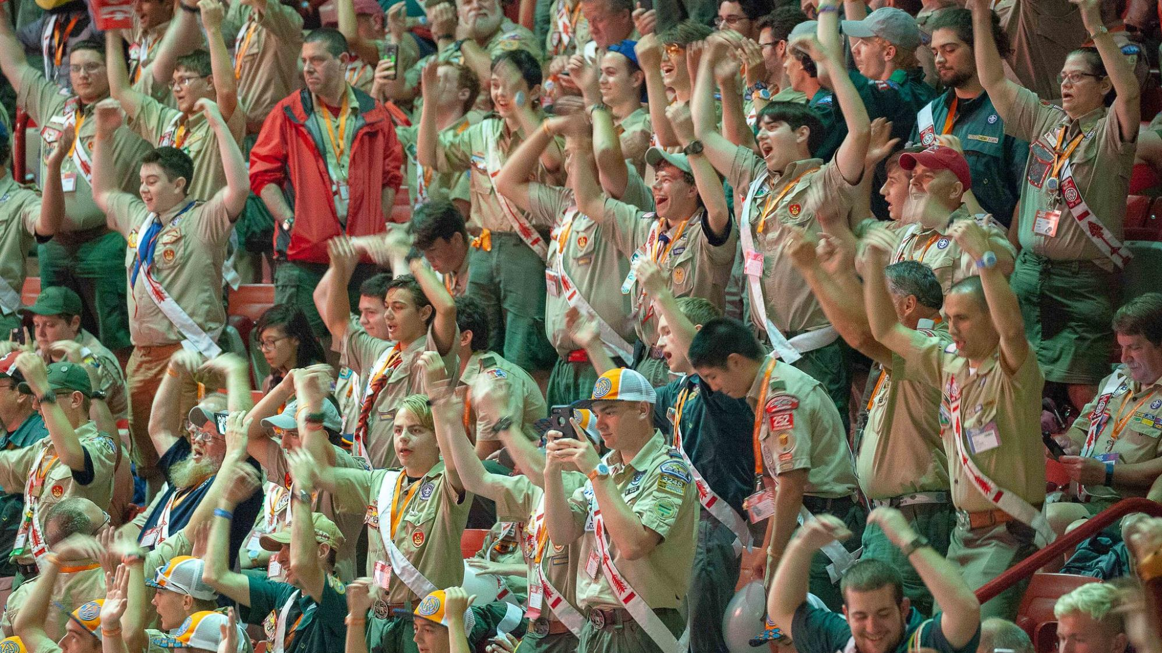

Slide 6
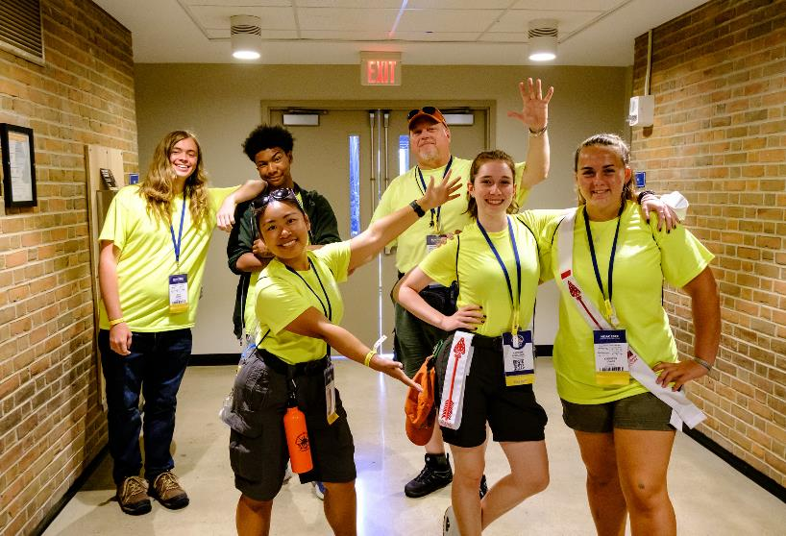
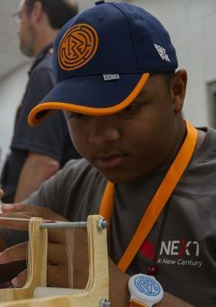
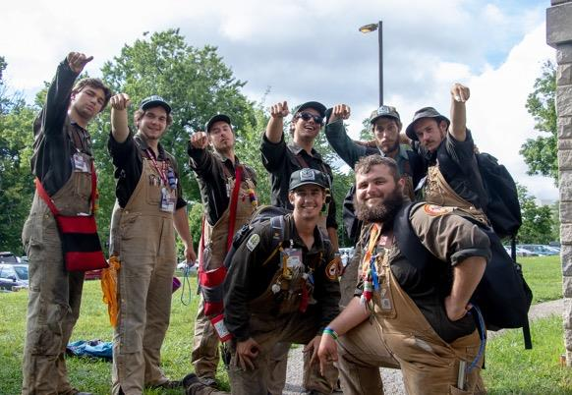
What is NOAC?
NOAC is a great way to learn more about the Order of the Arrow, learn all about the opportunities that exist in the OA, meet Arrowmen from across the country and have a great time!

Slide 7
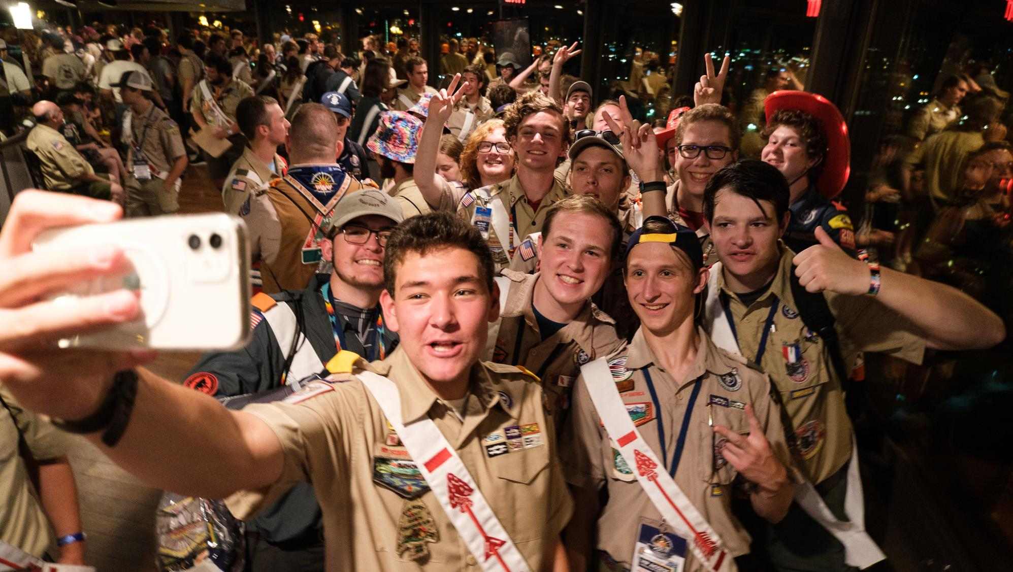


Slide 8
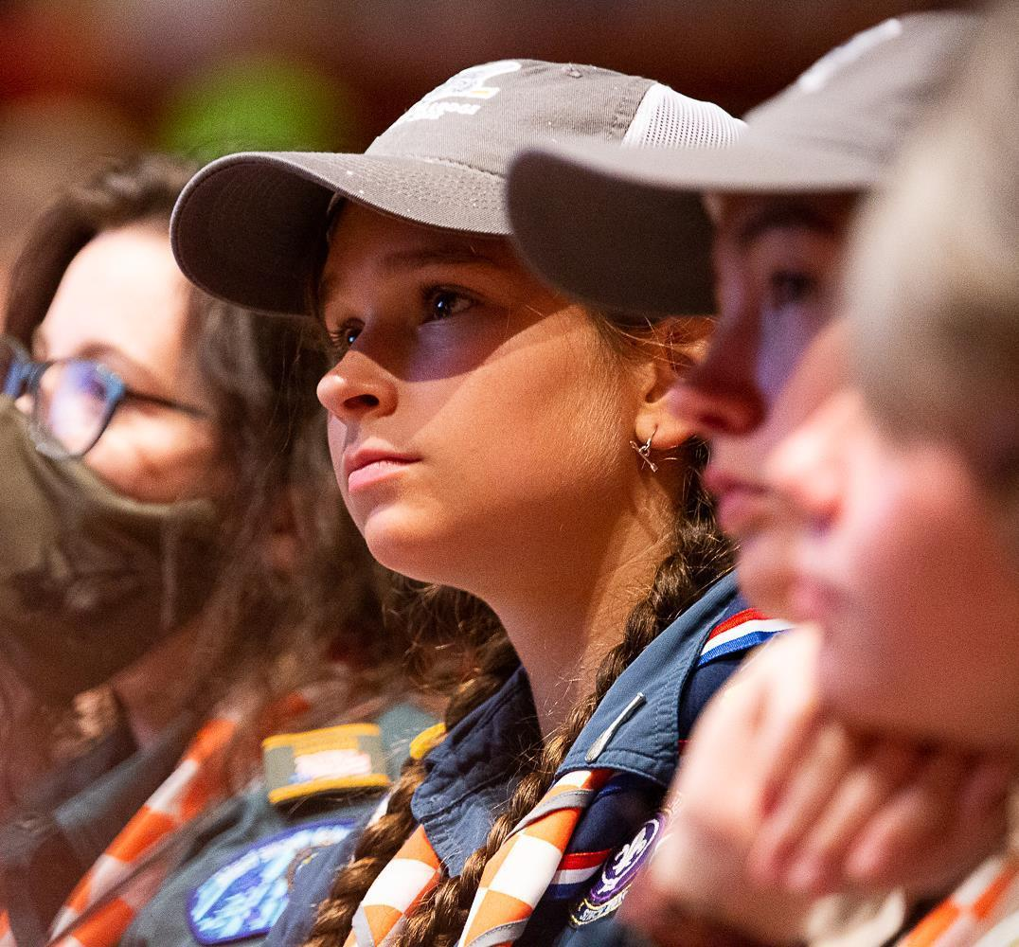
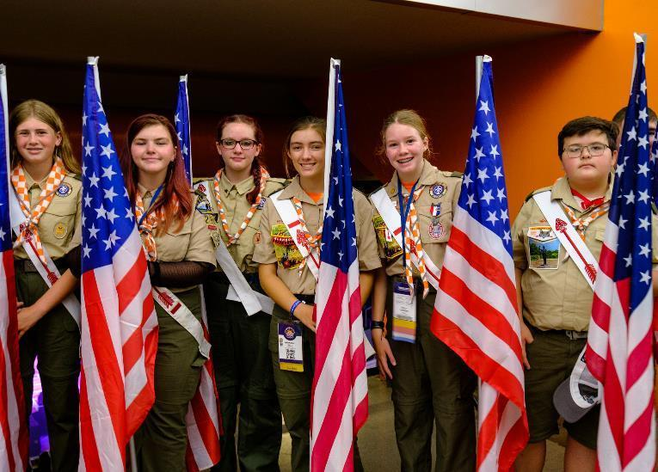
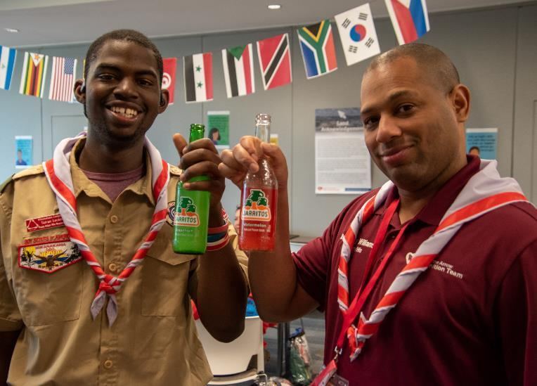

Slide 9



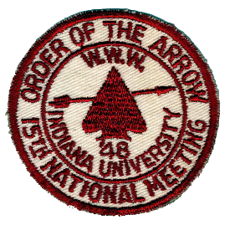

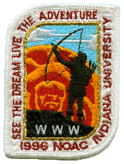




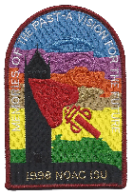

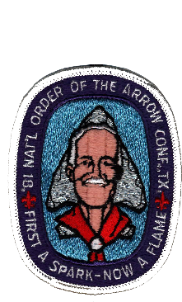

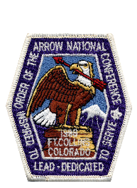

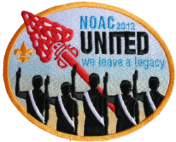




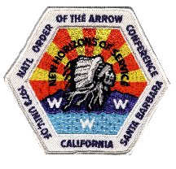
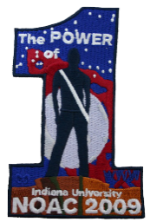

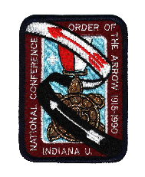
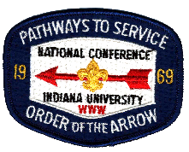
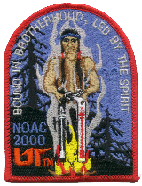





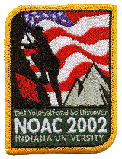
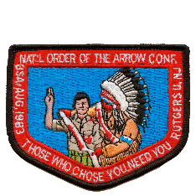
Did you know?
2024 will be the 35th national conference and the first-ever at the University of Colorado Boulder (CU). This is the first NOAC west of Iowa since 1988!

Slide 10
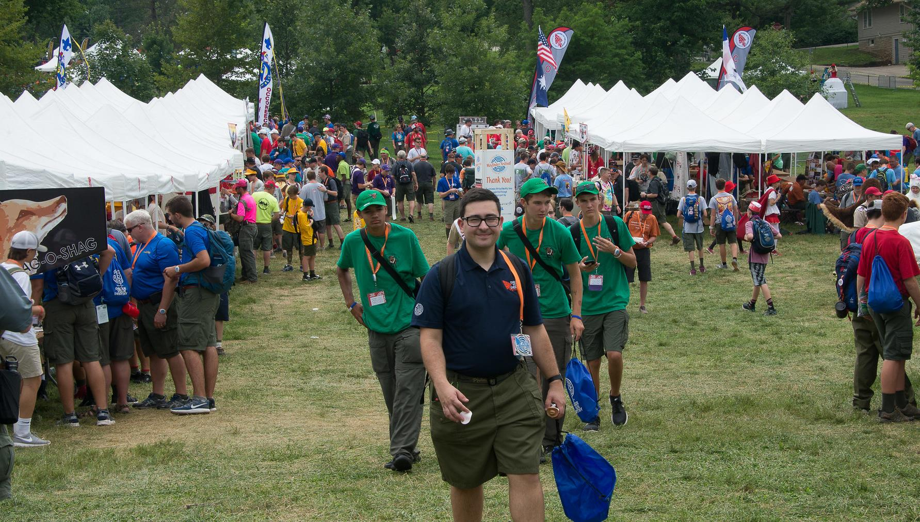

Slide 11
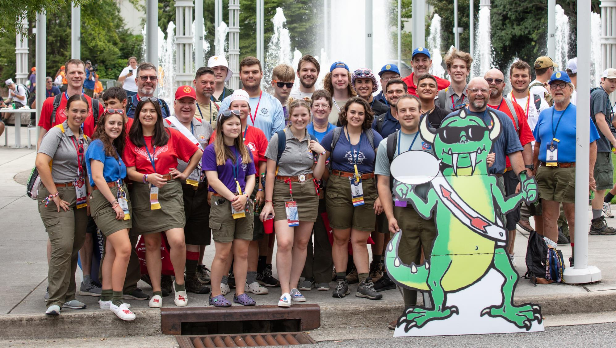

Slide 12
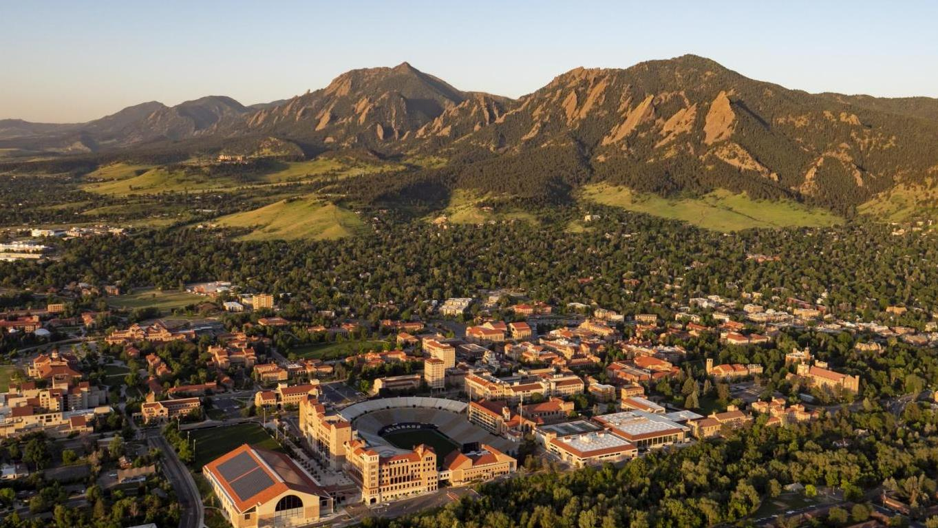
The University of Colorado Boulder

Slide 13

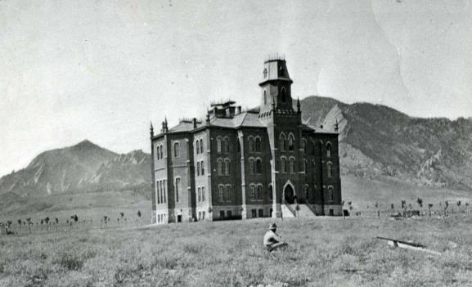
The University of Colorado Boulder
“Old Main” in the late 19th century
Founded in 1876, at CU Boulder, undergraduate and graduate students put their knowledge to use in areas of study ranging from archaeological finds in the arctic to improving the classroom experience to working with NASA to conduct research in space. CU Boulder is a member of the prestigious Association of American Universities and is one of the most beautiful campuses in the nation.

Slide 14
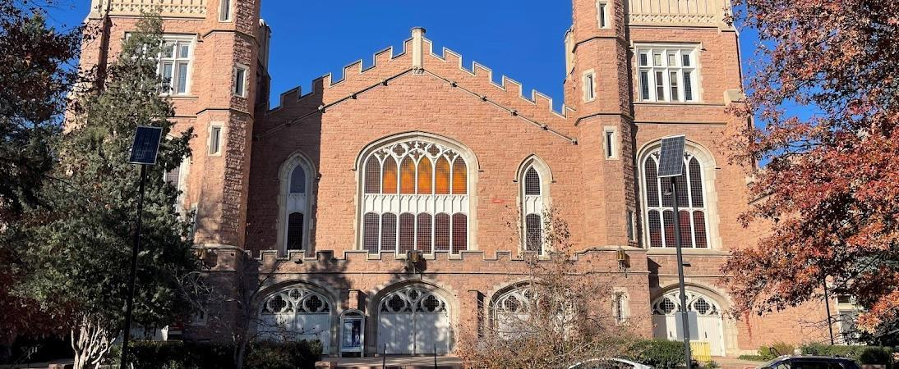
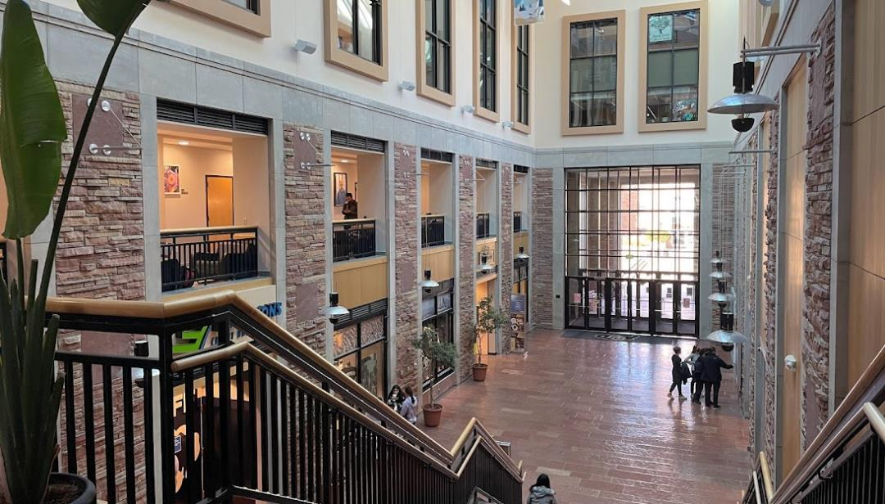
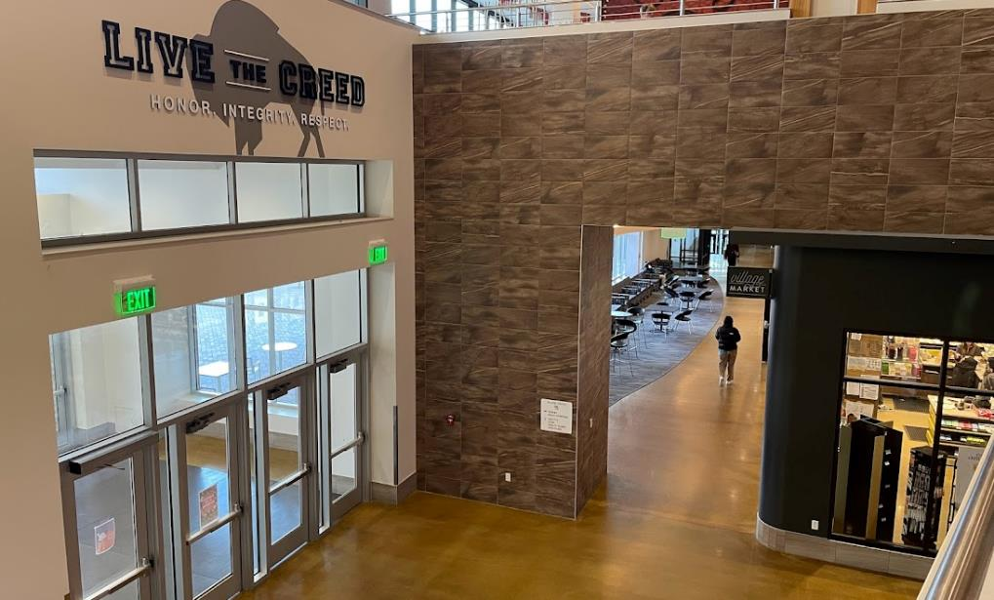
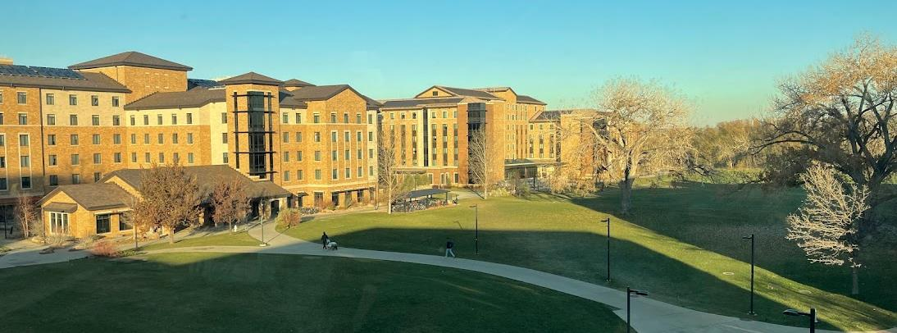

Slide 15
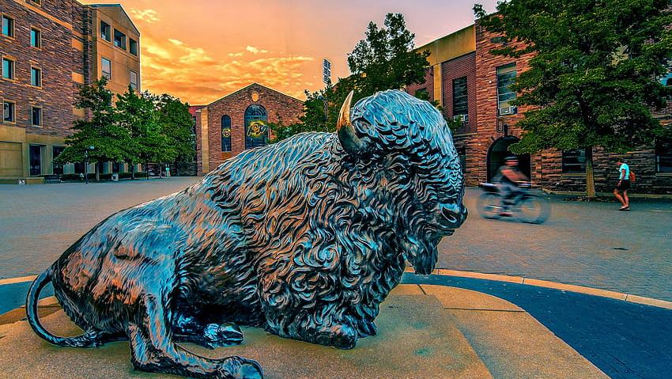

Slide 16
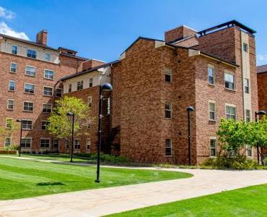
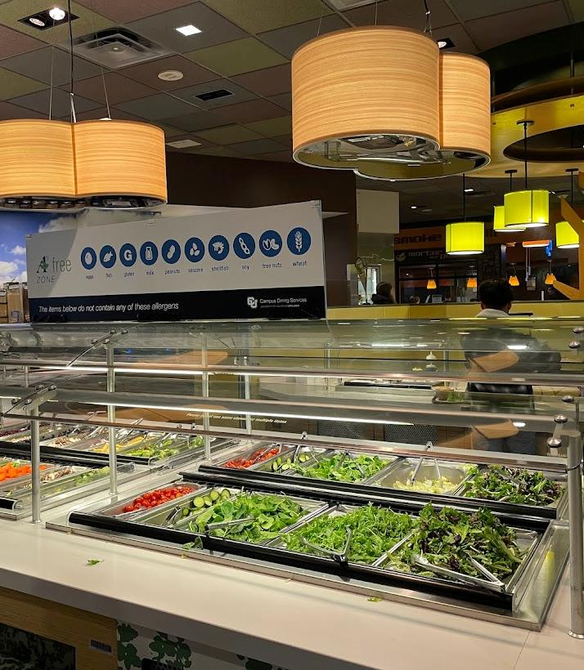
Experience University Residence Hall Life
Delegates and staff will be housed and fed in one of CU’s several residence halls. These amazing facilities will be your home base for the week!

Slide 17
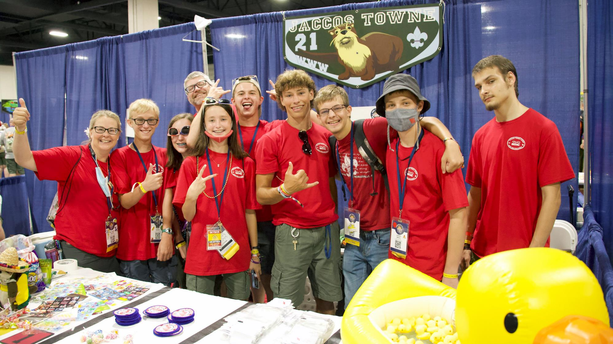

Slide 18
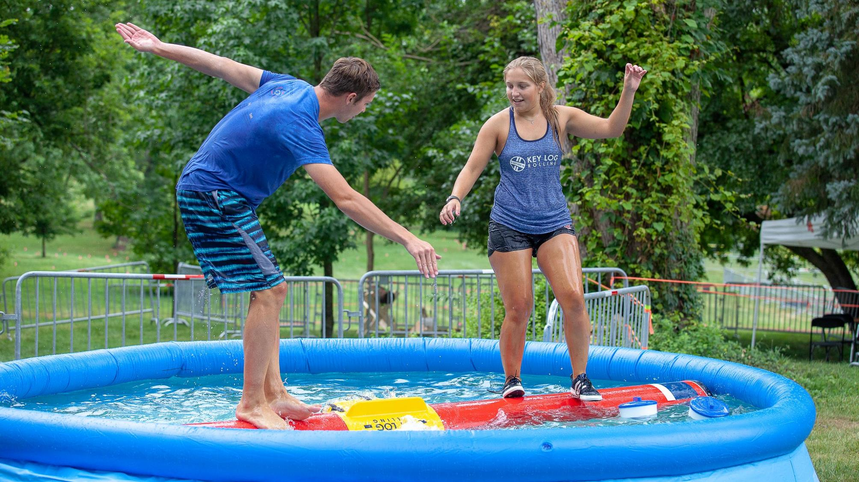

Slide 19


Boulder, Colorado
Boulder (pop ~104,000) sits at the foothills of the Rocky Mountains, in northern Colorado. To the west, the trail-lined Flatirons are craggy rock formations overlooking the city.

Slide 20
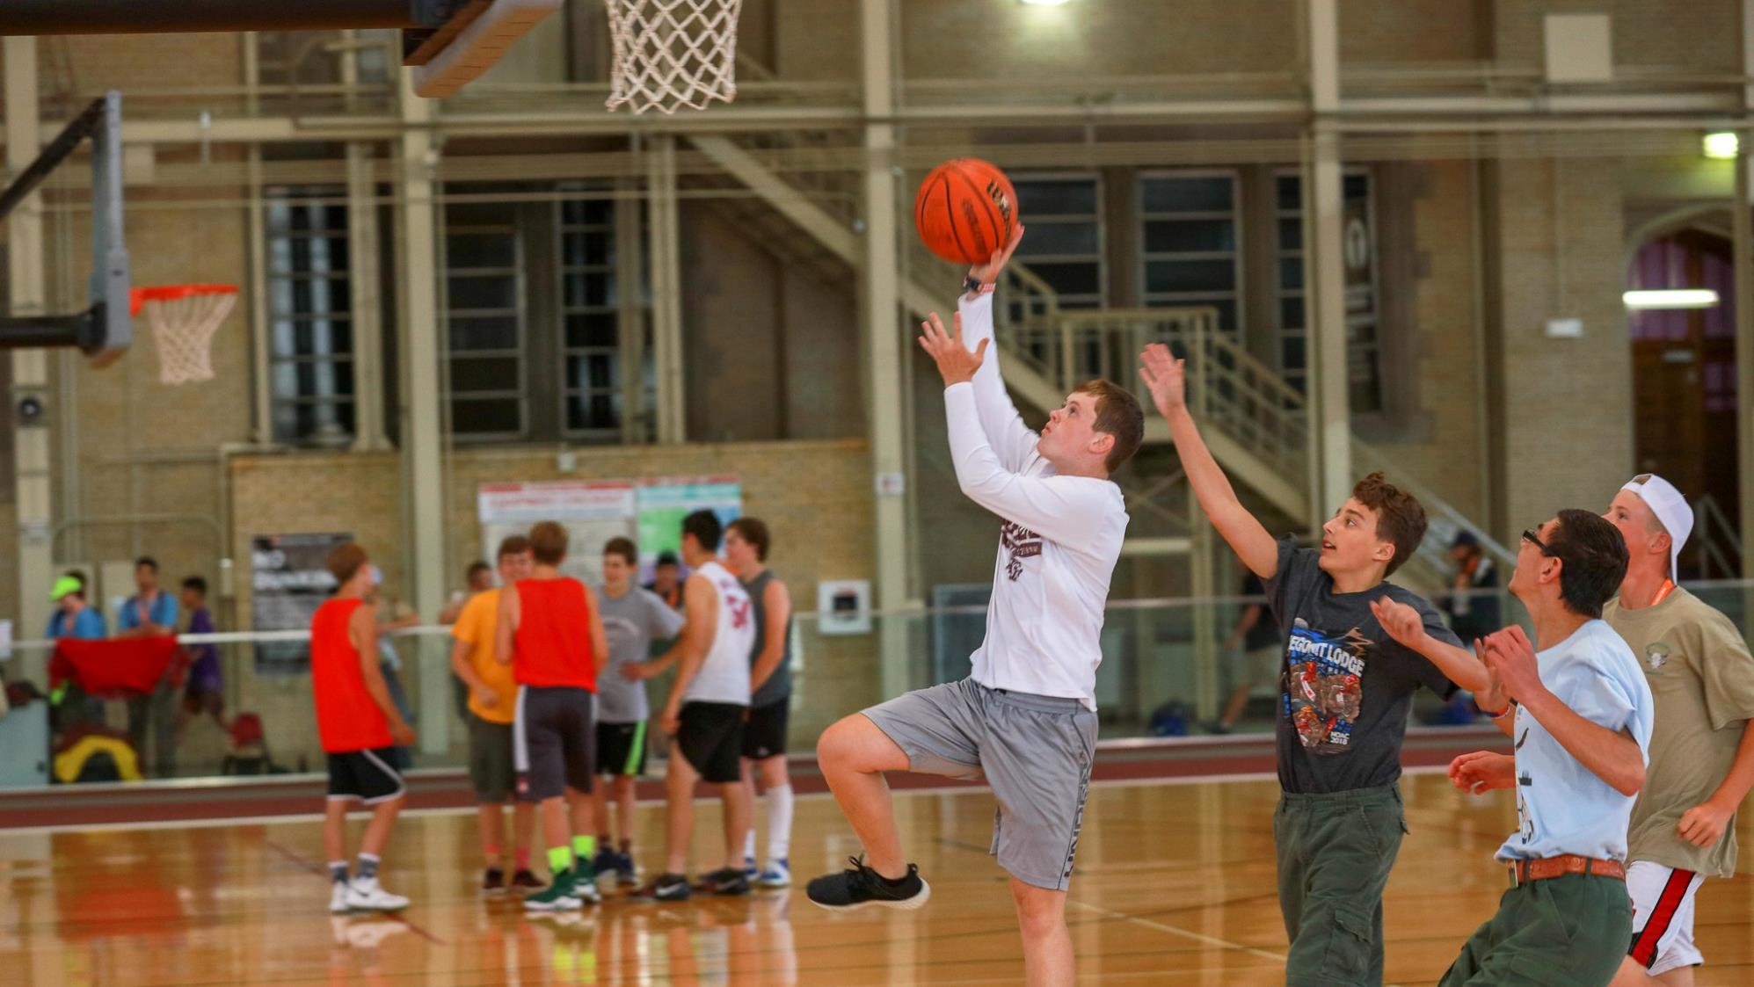

Slide 21
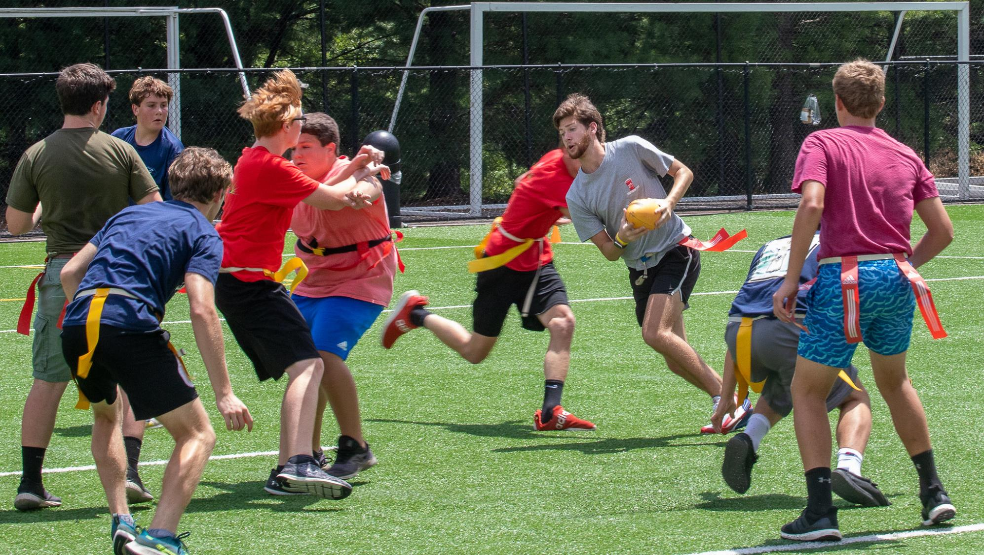

Slide 22
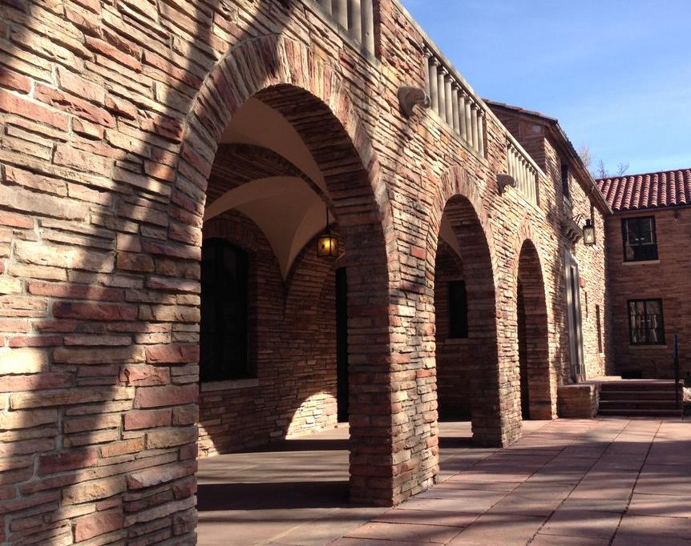
Did you know?
The University of Colorado at Boulder's buildings are built with red sandstone, quarried in nearby Lyons.

Slide 23
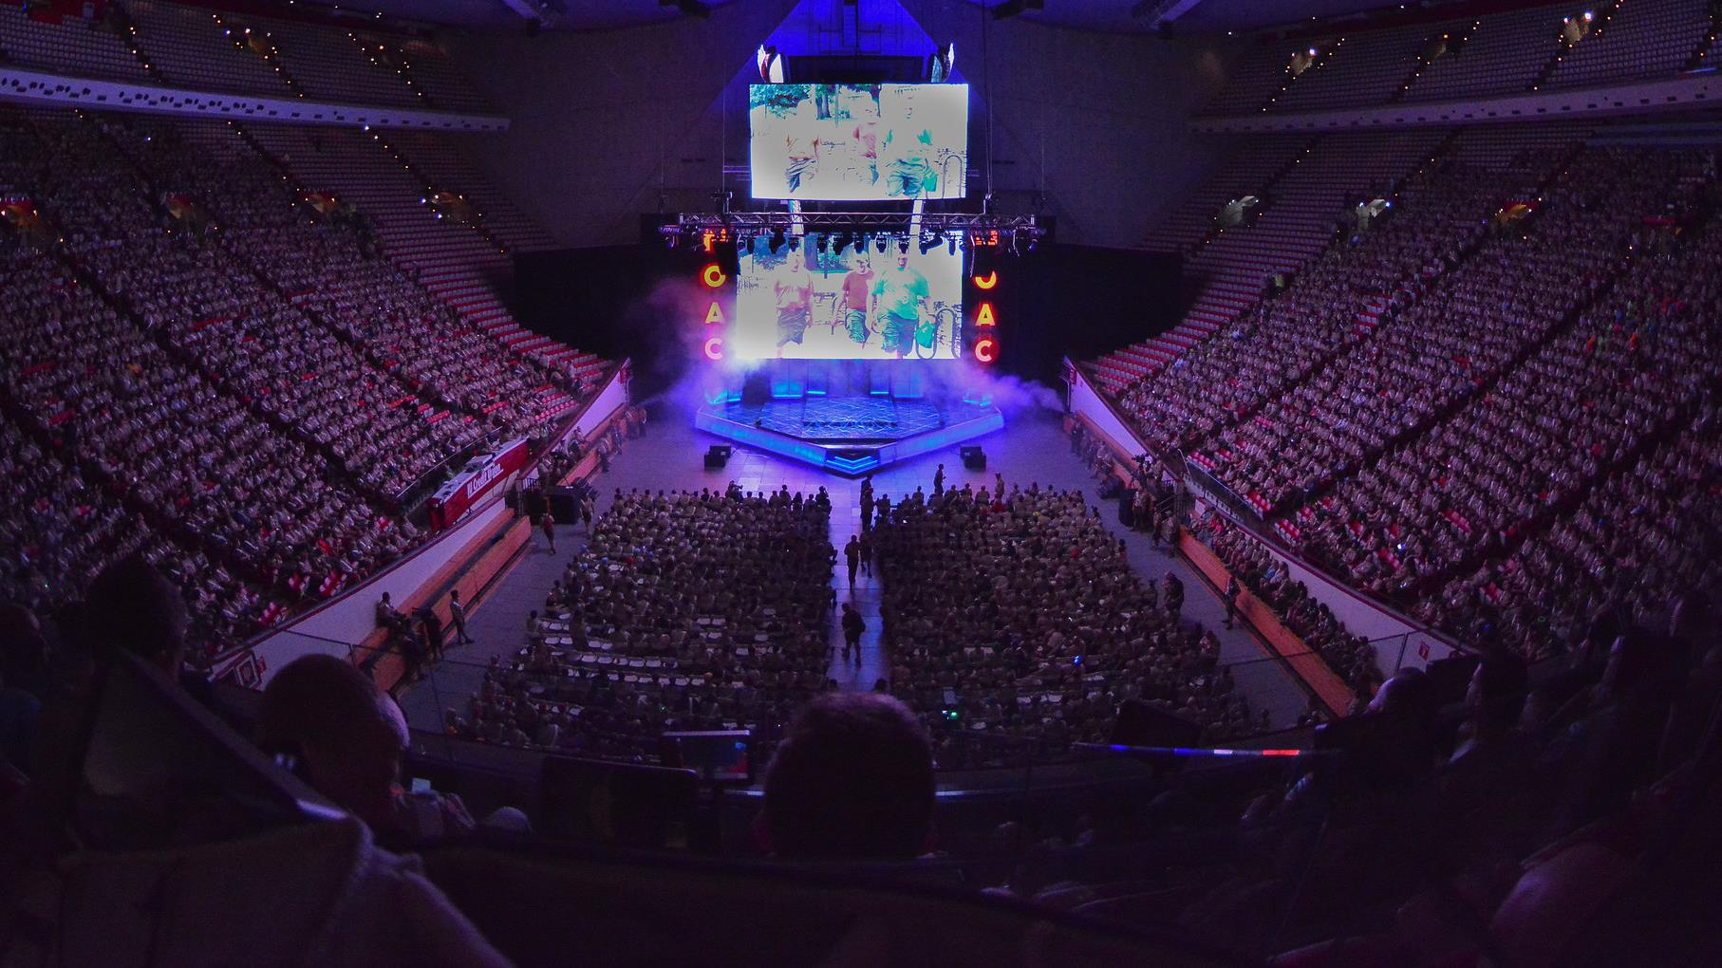

Slide 24
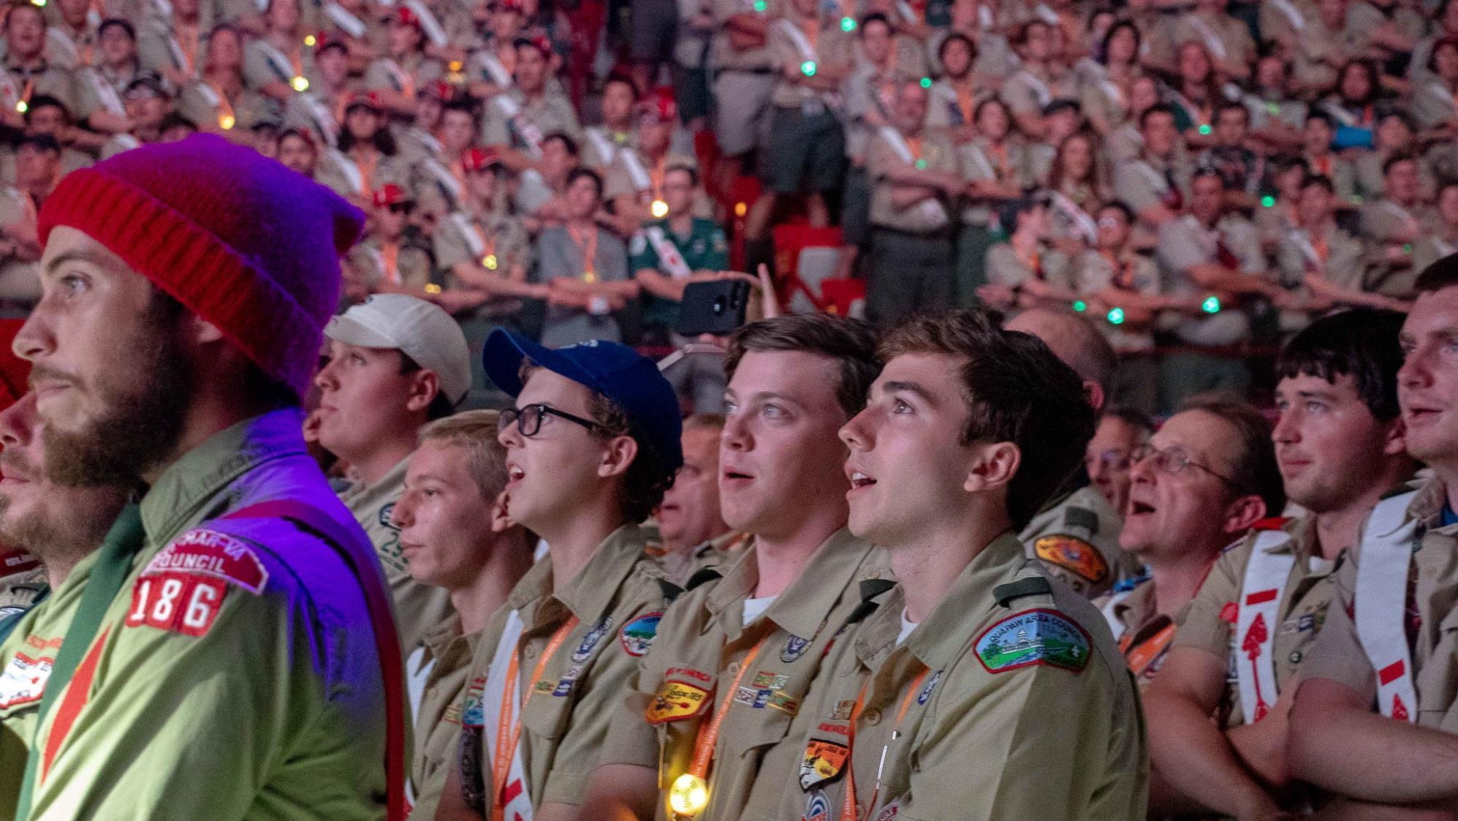

Slide 25
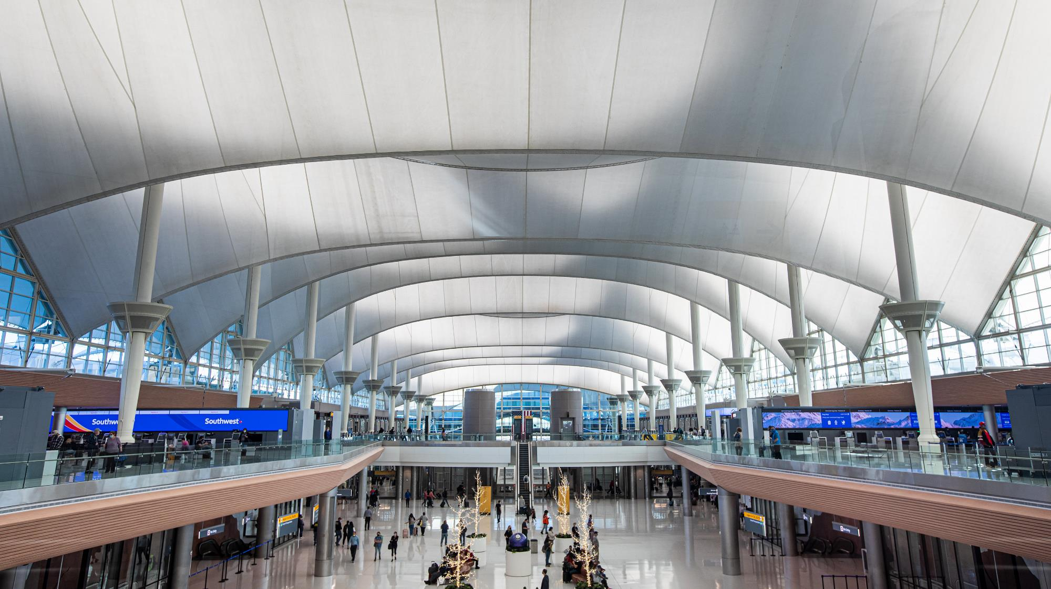
Denver International Airport (DIA)
DIA is the closest major airport located 42 miles away from Boulder, served by 25 airlines and with approximately 160 daily nonstop flights from major U.S. cities.

Slide 26
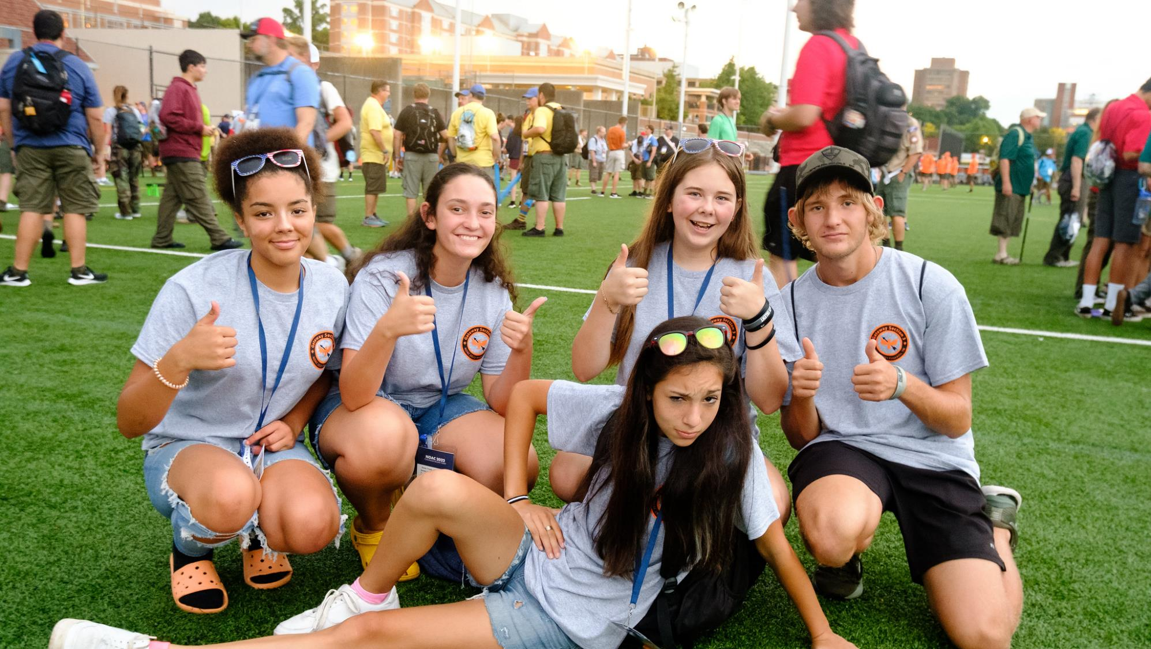

Slide 27
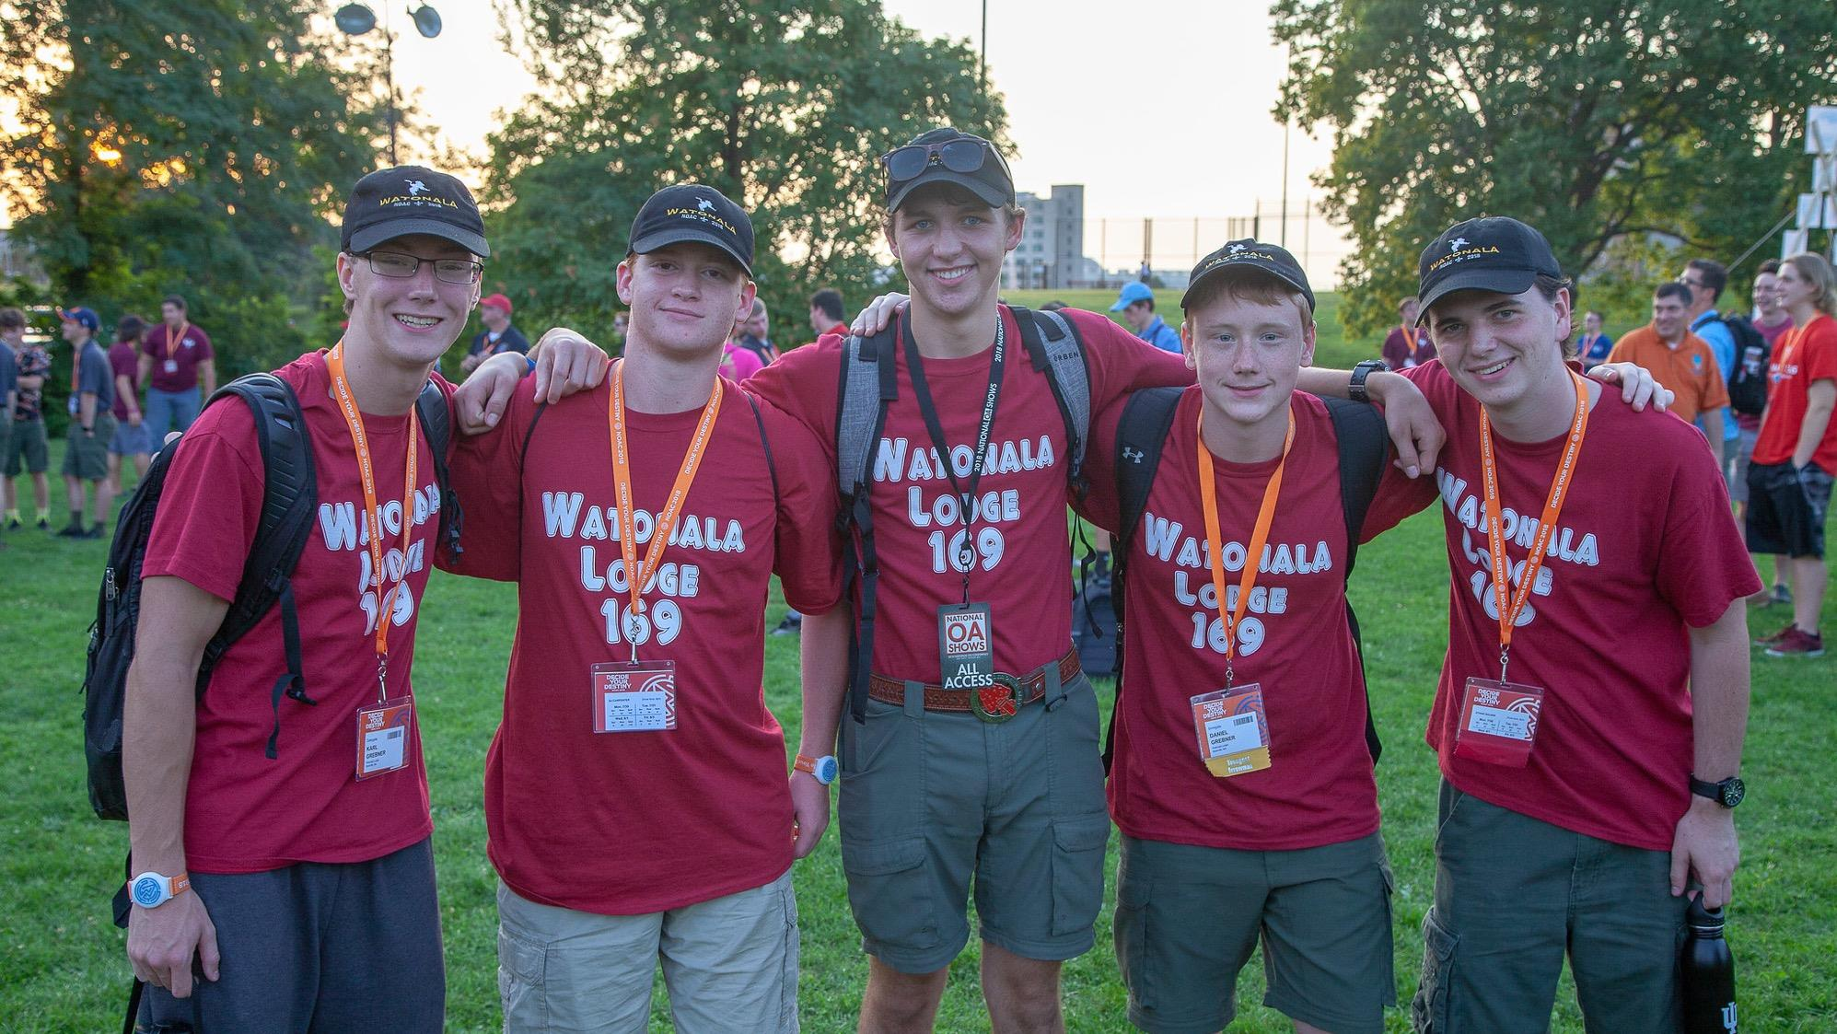

Slide 28
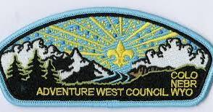
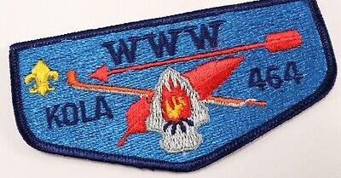
Did you know?
Boulder is home to the Adventure West Council and Kola Lodge – the official service council of NOAC 2024!

Slide 29


Slide 30


Slide 31

Weather
The average temperatures in Boulder in late July ranges from a low of 55F to a high of 80F

Slide 32




Slide 33


Slide 34

Conference Fee Structure
Delegate conference fees are paid through your lodge contingent and includes the promotion patch (delivered after receiving your paid deposit), conference patch, residence hall housing, 14 meals starting with Monday dinner & ending with Saturday breakfast, program materials, and credentials for access to conference training, program and shows. Staff and individual registrants register and pay individually.

Slide 35


Slide 36


Slide 37

Individual Registration
Adults (21 and over)
Scout executive approval
Premium hotel housing only
Register individually in NOAERS

Slide 38





Slide 39





Slide 40

Registration Opens in October
OA National Event Registration System (NOAERS) opens in October for contingent leaders, staff and individual registrants. Visit registration.oa-bsa.org.
Space on campus is limited to 6,000 delegates and staff!

Slide 41




Slide 42




Slide 43

Promotion Patch!
Upon your contingent’s registration and receipt of deposits, your contingent leader will be sent a promotion patch for each deposit to be worn in the ‘jamboree’ position above your right pocket. Staff and individual registrants will receive their promotion patch after submitting their deposit.

Slide 44





Slide 45




Slide 46


Visit Boulder
https://www.bouldercoloradousa.com/
Curious about activities and things for your contingent to do in and around Boulder? Check out Visit Boulder for more information on the following:
Flatirons
Hiking
Biking
Water Recreation
Kayaking & Rafting

Slide 47


Slide 48



FamilyID=Office_ArchiveTorn

Slide 49



Promotional Materials
Visit noac.oa-bsa.org for the latest promotional content that you can use to build your biggest and best contingent to a national OA conference yet!
Coming soon…
This slideshow
Promotion Video
Promotional Flier
Zoom background
and more…

Slide 50


Slide 51

See you at CU Boulder in 2024!

